Slide 1
NON -GAZETTED STAFF UNION
(ESTD. 19 SEP 1947)
INDIA METEOROLOGICAL DEPARTMENT
MINISTRY OF EARTH SCIENCES

Slide 2

Brief Introduction of the India Meteorological Department
IMD is established in 1875 & is a National Meteorological Service of the India.
One of the few departments in India which works round the clock.
IMD is functioning under the Ministry of Earth Sciences (MoES).
Principal Government agency in all matters relating to Meteorology, Seismology and Allied subjects.
Headquarter of IMD is at New Delhi with six Regional Head Quarters.
Provides vital weather services to public & all sectors including monsoon for common man, farmers, Industry, Defence etc. at par with services given by Railways, Defence services & other scientific research Organizations.

Slide 3
Global Requirement & Role of IMD
IMD is functioning due to Global requirement under World Meteorological
Organization (WMO).
WMO forms the policies which are implemented by all the member nations. India is one amongst them.
Weather services are meant for mankind and hence Government of the respective nations are responsible for implementation of its orders, recording of real time data, global exchange of real time data, validation and archival of the data.
This data is national scientific treasure which has to be stored and used for development.

Slide 4

SERVICES PROVIDED BY IMD TO NATION
Weather Services to Agriculture
Forecasting services to the national and international civil aviation sector.
WMO recognized training services to staff, public & foreign trainees.
Telecom Training to departmental & foreign trainees.
New satellite-based digital broadcast services.
Positional Astronomy Services.
Services for Shipping and Fisheries.
Climatological Services
Environmental Meteorology.
Hydrometeorology & Flood Forecasting.

Slide 5
IMD’s division dealing with specialized subjects
Agricultural Meteorology
Civil Aviation
IMD’s Meteorological Networks
Meteorological Telecommunication network
Surface Observatory Network.
Climatology
Hydrometeorology
Instrumentation
Meteorological Telecommunication
Regional Specialized Meteorological Centre
Positional Astronomy
Satellite Meteorology
Seismology
Training
Upper Air Observational Network.
IMD’s Radar network
Ozone Monitoring Network
Radiation Observatories
Voluntary Observing Ships (VOFs).
INOSHAC: - Indian Ocean and Southern Hemisphere Centre.
Air Pollution Monitoring
NWP System

Slide 6
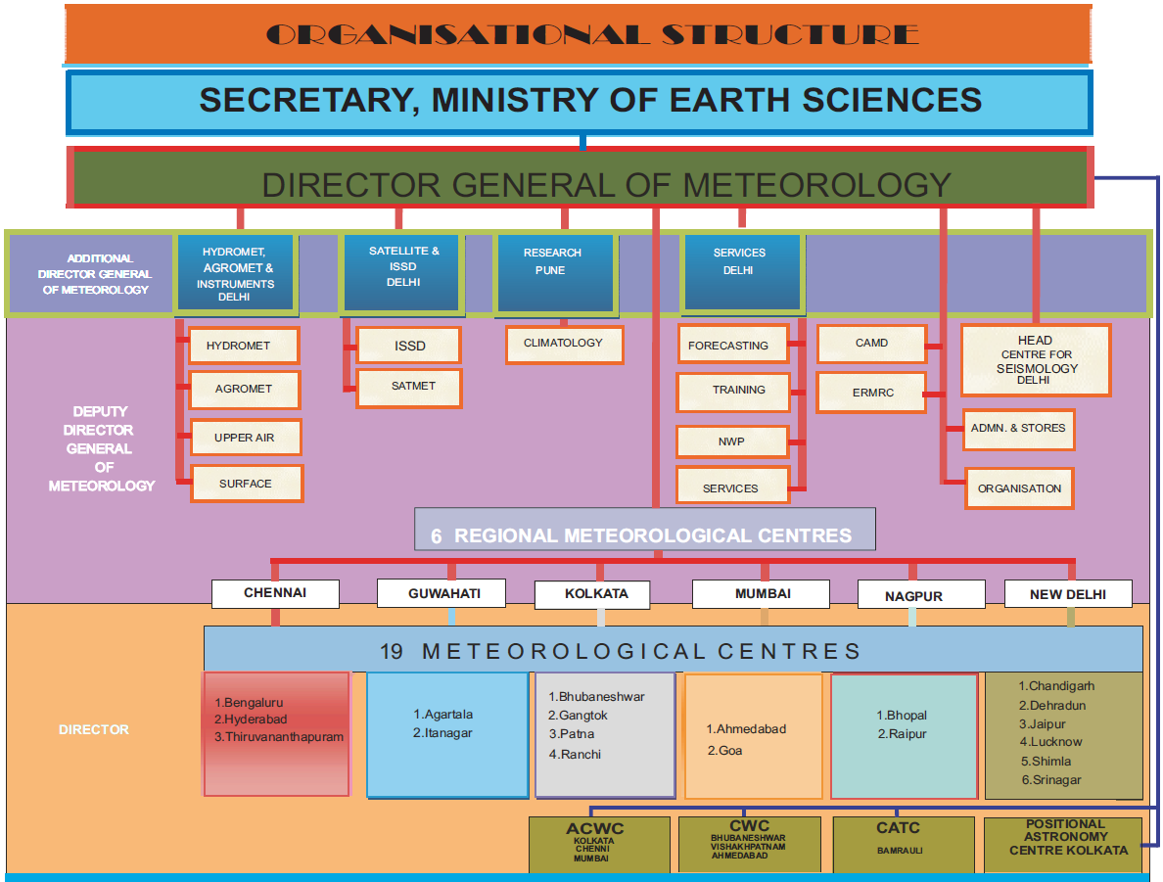
Organizational structure of IMD

Slide 7
Charter of duties of Gr-A, Gr- B and Gr-C
Group- A cadre
Group-B & C cadre
Heading the Administrative & technical units.
Implementation of IMD projects.
All type of administrative works.
They are not directly responsible maintenance of field stations .
Responsibility of analysis of data and forecasting.
As per the XIth and XIIth five year plan, Group A post in IMD are more into procurement of instrument and maintenance by means of AMC.
Submission of papers. Its more of documentation of real time weather events
Collection, assimilation, compilation, validation and archival of Met. data.
Operation, maintenance & upkeep of IMD networks.
Maintenance and inspection of all types of field stations, repair and calibration of all instruments including radars
Impart training as instructors at training Centers.
Recording & reporting of Met. Observations round the clock through out the year 24/365.
Techno-administrative work in addition to admin work.
Major role in scientific data generation on real time basis, transmission reception & service providing. Analysis of weather charts and helping Directors in issuing of various forecasts as per user requirement

Slide 8
Departmental Training Policy in IMD
Group-A officers
GP-Rs. 5400/-
With M. Sc
(Second Class)
First promotion after 20-25 years of service
Three official trainings in entire service.
Duration-14 months
Group-B officers
GP-Rs. 4200/-
With B. Sc. First class (60% and above)
Group-C staff
GP-Rs. 2800/-
& Rs. 1800/-
With SSC or equivalent technical qualification.
One two months training in entire service.
Three promotions in entire service.
Entry level official training
Duration-11 months
No training thereafter.
Five promotions upto GP-Rs. 8900/-

Slide 9
Disturbing Facts about policy implementation in IMD
Modified Flexible Complementing Scheme (FCS) was implemented in year 2011 by MoES only to Group A post due to their scientific criteria. Only the Group A post are described as scientific and rest all are General in nature.
Delay in implementing court orders.
Group B promotion channel was closed after 2008. Acute stagnation in all Group B and C posts.
No records on department’s actual status i.e. Scientific/operational/technical till date.
Five time bound promotions for Group-A officers & only one promotion to Group-B and C cadre in entire service.
Restructuring of only Group-B cadre is approved by DoPT but its implementation is still pending.

Slide 10
Status of Group-B staff Restructuring in IMD
The 6th cpc mentioned that SO will benefit due to restructuring. This is not yet implemented.
Details of restructuring of Group-B staff approved by MoES & DoE in November-2014 is as follows:-
Restructuring of Group-C is still lingering.
Sr. No. | Existing Designation & pay scale | Existing strength | Designation & pay scale proposed by IMD & approved by Finance Minister | Strength proposed by IMD & approved by Finance Minister
1. | Scientific Asst./PB-2, GP-4200 | 2465 | Scientific Asst. ‘A’/ PB-2 – GP- 4200 | 1972 (-493)
2. | Asst. Meteorologist Gr. II / PB-2, GP-4600 | 732 | Scientific/Meteorological Asst. ‘B’ /PB-2 -GP -4600 | 980 (+248)
3. | Asst. Meteorologist Gr. I / PB-2, GP-4800 | 426 | Scientific/Meteorological Asst. ‘C’ /PB-2 –GP-4800 | 512 (+86)
4. | Scientist ‘C’/PB-3, GP-6600 | 132 | Scientific/Meteorological Officer-I/PB-3, GP-6600 | 151 (+19)
5. | Scientist ‘D’/PB-3, GP-7600 | Prior to extending benefit of MFCS, 20 posts of DDG ( now scientist ‘E’ ) & 5 posts of ADG ( now scientist ‘F’ ) were in existence. However these posts are not enumerated at present. | Scientific/Meteorological Officer-II/PB-3, GP-7600 | 45 (+45)
6. | Scientist ‘E’/PB-3, GP-8700 |  | Scientific/Meteorological Officer-III/PB-3, GP-8700 | 17 (+17)
 | Total | 3755 |  | 3677 (-78)

Slide 11
Issues not addressed in recent Restructuring by MoES/IMD.
Nomenclature of posts after restructuring as per unions suggestions.
Special departmental status as Operational Department at par with Railways, Defence etc.
Issue of office order for the posts created due to restructuring in all designations/posts as per DoPT norms.
Filling up of all vacant posts of AM-II/AM-I before restructuring.
Framing & approval Recruitment Rule’s (RR) of newly created posts at earliest.
One year training at entry level followed by refresher courses.
Amendments in RR with amendment in service classification as “Scientific/Operational”
Up-gradation of GP of Scientific Assistant from 4200 to 4600 based on qualification and work criteria..
Due weightage to stagnation (no promotion for 15 years) of staff in restructuring.
Revision of extra duty allowance, OTA, NW etc.
Restructuring of Technical/Mechanical posts of Gr-C cadre.

Slide 12

Justification for starting GP of Rs. 4600/- for Sc. Asst.
Cadre :- Feeder cadre in Group- B, Non-gazetted cadre.
Qualification :- B. Sc. (Physics) with 1st Class/Diploma in Elec. & Telecom Engg. with 1st class. .
Duties include Scientific/Technical, operational, essential and Administrative work connected with Meteorological Observatories, Weather Forecasting, Climatology, Geophysics, Radio Meteorology etc.
However SSC through its advt. of recruitment in 2012 asked for eligibility criteria of B.E./B. Tech in lieu of Diploma in Elec. & Telecom Engg.
Recently 311 SA’s are recruited in 2013 out of 426 with B. E. as qualification & out of this only one person is with Diploma in Elec. & Telecom Engg.
Prior to 6th CPC, Senior Observer & Sc. Asst. cadres were drawing Rs. 5000/- & Rs. 5500/- pay scale respectively. Since 6th CPC recommended merging of Rs. 5000/- & Rs. 5500/- and awarded Rs. 4200/- grade pay in PB2.
Due to this merger the promotional post was lost. Moreover the present SA’s are discharging higher responsibility but drawing lesser salary, hence this supervisory cadre of Group-B grade pay may be enhanced to Rs. 4600/-.
The Administrative staff where the selection is processed using criteria appearing for SSC exam, All India Service and with Graduation as qualification the scale applicable is 4600 GP. Though the SA post fulfills all the above criteria the GP 4600 is not granted to this cader.
Ground realities in duties of Scientific Assistants: -
  Most of the SA’s are posted at field stations (airports) particularly at aerodromes and are issuing forecasts which is the responsibility of Gazetted officer.
  Though the qualification is scientific, work is scientific but MoES refused to implement FCS to group B as the posts are not scientific as per the FCS norms , however charter of duties and the RTI reply given by IMD clearly indicates that the posts are scientific and operational.
  Most of the SA’s are now forced to perform works of AM level without any monetary benefits in IMD.

Slide 13
IMD’s Departmental status & Duty Nature – Need for scientific/operational status & classification.
IMD’s departmental status i.e. whether Scientific / non-scientific /operational.
Present service classification doesn’t cover existing works performed.
MoES / DoPT unaware of IMD’s departmental status & classification.
No provision of leave reserve staff for leave off.
OTA rates not revised though the 6th CPC has said that all operational posts that are governed by its extant rule should get this allownace.
OTA ceiling on GP of Rs. 4200/- must be removed. All posts working for operational requirement should get OTA irrespective of their grade pay.
Special OTA and NW scheme should be framed for IMD.
Staffs are performing roster duties hence criterion of G-duty are non-applicable.
Roster duties damage health & life, hence benefits like OTA, NW, Stress allowance, infrastructure etc. should be introduced in this department
CL should be increased to 18 for operational duties. Cash incentives should be paid for those working during disastrous weather conditions.

Slide 14
Non-linearity in pay-scales- Degradation of promotion prospects in IMD
Comparative study of 4th/5th/6th CPC pay scales shows that there is complete disparity in GP system introduced in 6th CPC.
There is gradual increase of Rs. 400/- in GP from GP- 4200 to GP-.4600/- for non-gazetted (Gr-B) cadres.
But suddenly there is decrease of Rs. 200/- in GP from GP -4600/- to GP . 4800/- which is gazetted cadre.
Hence GP of Rs. 4800/- must be abolished.
Thus GP 4800/- has totally downgraded financial benefit in IMD.
Promotion as Gazetted officer in IMD from lower cadre gives only Rs. 200/- increase in GP.
Gr-A officer joining at GP of Rs. 5400/- continuously getting Rs. 800/- or more hike in GP
New GP of Rs. 5000/- in place of Rs. 4800/- , Rs. 5600/- or Rs. 5800/- in place of Rs. 5400/- may be introduced.
Thus there is jump of only Rs. 200/- in GP in two successive promotions corresponding to GP 4600 & GP 4800.

Slide 15
Demerits of GP system in IMD- Effect on promotional benefits of staff
Merger of Senior Observer (5000-150-8000) with Scientific Asst. (5500-175-9000).
Merging unjustified as only pay scales & staff strength are merged- no financial benefit due to merging.
Affect on seniority of staff merged & pay .
Non-linearity in Grade Pay introduced in 6th CPC. It has also created pay anomaly.
Abolishion of GP system & pay scales shall be kept on basic pay as per earlier practice.
Administrative lacunas & delay in taking decision on policy matters in IMD, non-gazetted staff is totally deprived of promotional benefits.
Gazetted cadre availing promotion every 5 years but non-gazetted cadre is stagnated in one cadre for 10 years.
No financial benefits to staff after promotion except MACP.
Either FCS or MBPS mode of promotion with financial; benefits may be introduced in IMD
Complications in such merging of cadre’s w. r. t. workload, seniority, pay band etc.
Only two promotions in entire service period.

Slide 16
Benefits to Mechanic cadre – Most deprived cadre in IMD
Deprived cadre in IMD & is victim of 21st century technology.
With advancement in world technology and procurement of latest equipment workload on this cadre has increased. No special efforts by IMD to train this cadre.
An AMC mode of maintenance of instruments is adapted but this model cannot sustain in long run due to fast technological advancement and slow movement in Govt. approvals.
Caters to IMD’s instrumental & technical requirements.
This Cadre must be equipped with latest technology for national interest.
Utilized for maintenance & calibration of various instruments of IMD networks.

Slide 17
Restructuring of MTS – Justice to most deprived cadre.
Creation of posts in Administrative/Technical wings for career prospects.
Technical Nomenclature should be defined instead of MTS.
This cadre is used for the technical work such as filling of hydrogen gas (which is hazardous) and setting of instruments during observation time.
There is no financial /career prospects for this cadre.
Totally neglected cadre after 6th CPC.

Slide 18
Special allowances to the staff working at Airports and International Airports
MWO’s at four International Airports providing round the clock aviation forecasts. Airports are located far away from the city where transport facility is not available.
Tower seat & AMSS seats are working continuously (6/12 hrs duty) without break.
Performing duties during monsoon/winter is stressful at tower.
Deprived of even snacks & refreshments as well as vehicle facility.
No provision of any compensation to these staff at par with AAI staff
Special allowances like stress allowance, health allowance at par with AAI. Cash incentive should be given during disastrous weather events.
More that 1000 flights per day are handled by these offices.

Slide 19
Some Key financial issues in IMD
Medical Insurance
Necessity as staff is posted at remote field stations all over India.
No suitable infrastructural & medical facilities are available at such places.
Contingent staff deployment in lieu of staff shortage
Acute staff shortage (particularly S. A.’s & Group C (MTS)) at field stations.
Situation becomes worst during monsoon season/bad weather.
Settlement of TA/DA bills on tours
Crucial issue & especially deliberately created by IMD’s administration.
Tour bills of IMD staff who are visiting remote field stations are not settled as per rule
Need for Free Medical insurance/cashless medical treatment facility.
Field stations are managed with minimum staff.
Difficult to perform round the clock duties at field stations without MTS staff.
Operational duties are hampered putting staff under physical/mental stress .
Difficult for these staff to get food, lodging etc. bills in remote areas.
Intermediary expenses during tour are not given to these staff due to non-availability of bills.
Field stations where bill are not available shall be exempted from producing it.

Slide 20
(Issues to be addressed by this pay commission)
Extra Duty & Compensatory off
This department should never come under recruitment ban under any circumstances. Hence special status may be given.
At present Rs.18.10 is paid per hour for extra duty. Hence a permanent formula may be introduced for compensating for extra duties unlike India press and Central excise departments.
While on field stations tour the official should not be asked for submission of bills for claims.
As per the nature of duties extra work cannot be stopped. Hence for compensating the extra duty and night duty a separate scheme may be introduced.
Cash incentives may be introduced for all the staff members working under disastrous weather conditions such as cyclones etc.
Group C (Technical) and Mechanical grades should also be up-garded as per the technology advances and work assigned.
The Grade pay of Scientific Assistants may be upgraded to 4600 at par with the central secretariat service assistant.

Slide 21

Consolidated Demands
Special Departmental status to IMD considering its operational requirements.
Rs. 4600/- GP to Scientific Assistant cadre at entry level.
Solution to Extra duty & compensatory off. Revision of OTA/NW ,
Immediate restructuring of Group-C cadre (MTS & Mechanics) as per proposals submitted by IMD/MoES recently.
Financial & promotional benefits to Mechanics cadre.
OTA/NW at par with salary. Cash incentives during disastrous weather events & other allowances.
Special allowances to staff working at International Airports.
Linearity in pay scales of Gr-B/C staff & abolition of GP system.

Slide 22
Thank you on behalf of CEC, IMD-NGSU

